Slide 1

Precision Oncology & Stomach Cancer
Dylan, Kevin, Lindsay and Padraic

Slide 2
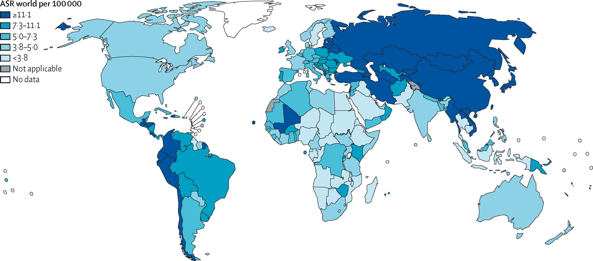
What is stomach cancer?
Stomach cancer - the second most common cause of cancer-related death
[Age standardized rates of stomach cancer incidence by country]
Highest incidence rates in Japan, China, South America, and Eastern Europe [1]
Notes:
Stomach cancer, or gastric cancer, is the second most common cause of cancer-related death in the world, with the highest incidence rates in Japan, China, South America, and Eastern Europe.
This here is an age standardized chart of stomach cancer incidence, which means that it accommodates for the drastically different life expectancies of different countries.
Stomach cancer also has very low survival rates upon diagnosis: in the US, the average survival rate for stomach cancer is only 10%.

Slide 3
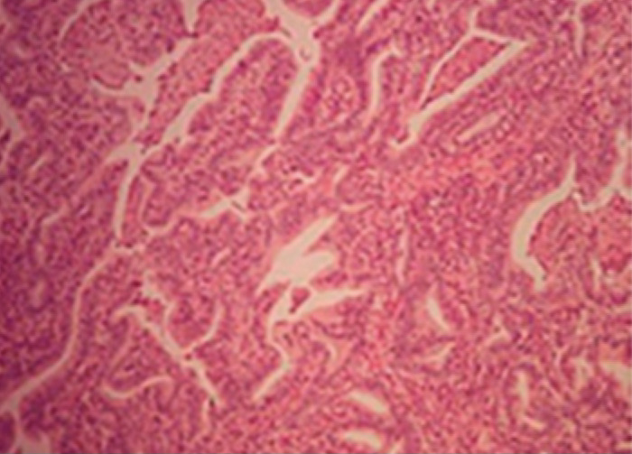
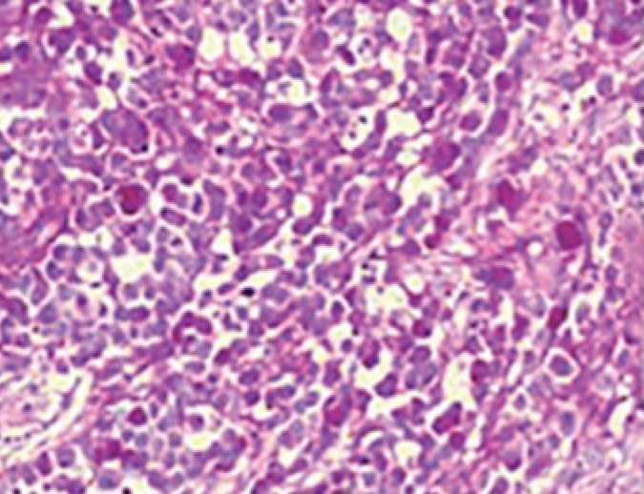
How is it classified?
Analysis of stomach cancer is difficult due to its heterogeneity of both etiology and histology
Gastric cancer
Non-Hodgkin's Lymphoma
Adenocarcinoma (~90%)
Leiomyosarcoma
Intestinal
More commonly linked to environmental factors
Characterized by ulcers in the distal stomach
Biopsy will show cells forming a cohesive mass
Diffuse
Highly metastatic
Cells infiltrate the stomach wall without forming a discrete mass [1]
Intestinal type adenocarcinoma
Diffuse type adenocarcinoma
Notes:
Stomach cancer is complicated due to the complexities of its origins.
In general, it is categorized into adenocarcinoma, non-Hodgkin's lymphoma, or leiomyosarcoma, dependent on the tissue it originated from. Adenocarcinoma, which originates from the epithelial tissue that lines the interior of organs, is very much the majority, and then beyond that adenocarcinomas are further categorized into either intestinal or diffuse.
Intestinal adenocarcinomas - More commonly linked to environmental factors, form a discrete mass, or tumor
Diffuse, or undifferentiated – Tend to be more metastatic, advance more quickly, will not form a discrete tumor but rather infiltrate directly into the wall of the stomach

Slide 4
Risk factors
Pre-existing Conditions | Environmental Factors | Genetic Factors
Chronic atrophic gastritis | Low socioeconomic status | Hereditary nonpolyposis colorectal cancer
Pernicuous anemia | Cigarette smoking | BRCA2 mutation
H.pylori (stomach ulcers) | Alcohol consumption | Family history of gastric cancer
Barrett’s esophagus | Diet | Blood type A
Menetrier disease |  | MTHFR polymorphisms
Gastric polyps
Obesity
Notes:
Very complicated: lots of variety. A person can have all of these and not develop cancer, and then a person can have none of these and develop it.

Slide 5
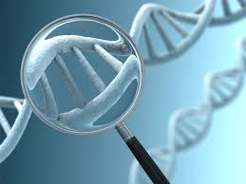
Stomach cancer and precision medicine
Tests for deletions of alleles in tumor suppressor genes that are mutated in stomach cancer
APC
P53
Intestinal
ErbB-2
ErbB-3
Diffuse
K-sam
Notes:
There are certain somatic alterations that have been linked to stomach cancer: specifically deletions in the alleles of APC or p53 gene.
In addition, the intestinal and diffuse subtypes have unique genetic characteristics that can be tested for. Intestinal types are characterized by overexpression of proto-oncogenes for the epidermal growth factor receptor, while diffuse types have abnormalities in the fibroblast growth factor systems

Slide 6
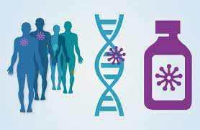
Targeted therapies
Gastrectomy
Ablation
Adjuvant chemoradiotherapy
Notes:
Gastrectomy: complete or partial removal of the stomach
Ablation: freezing or burning away the tumor tissue
Adjuvant chemoradiotherapy: combination of cytotoxic drugs and high-energy rays, controversial due to inconsistent results

Slide 7
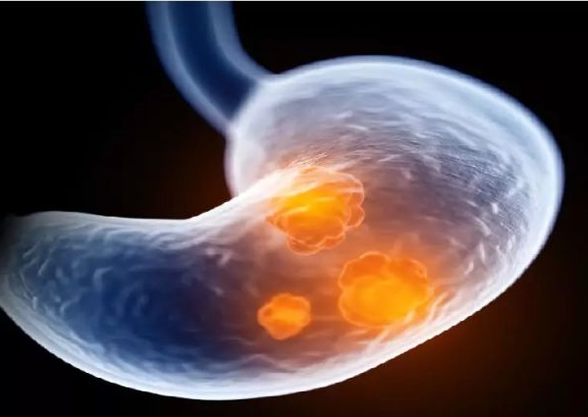
Targeted drugs for Stomach Cancer
Surgery and chemotherapy are the main components of the current clinical comprehensive treatment of gastric cancer. However, most chemotherapy drugs have problems such as toxic side effects
Studies have found that enhancing the targeting of drugs by changing the dosage form of the drugs can significantly improve the effectiveness of chemotherapy drugs, and can significantly reduce the toxic side effects of drugs.

Slide 8

Targeted drugs for Stomach Cancer
Targeted therapy selectively transports drugs to gastric cancer tissue cells and metastases through a specific guiding mechanism, so that the drug can exert its effect at the lesion site as much as possible, so it has no significant effect on normal tissue function, and can maximize the efficacy of the drug and reduce toxicity and side effect. At present, the targets of gastric cancer targeted drugs mainly include EGFR, HER-2, VEGF, VEGFR and so on.

Slide 9
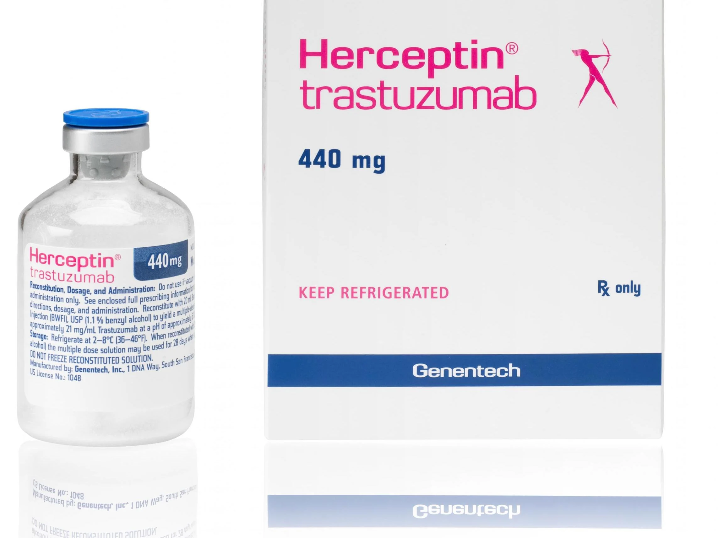
Drugs that target HER2
Trastuzumab(Herceptin) is a monoclonal antibody, a man-made version of an immune system protein, which targets HER2. Adding trastuzumab to chemo can help some people with advanced, HER2-positive stomach cancer live longer than just chemo alone.

Slide 10
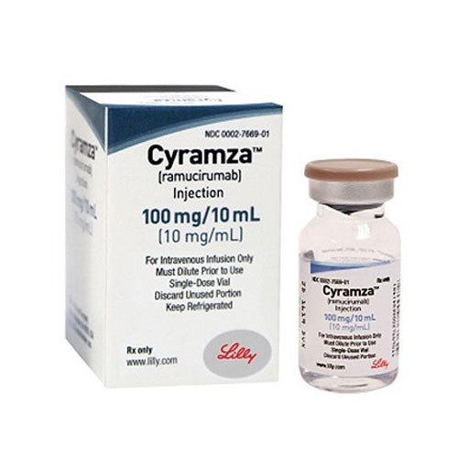
Drugs that target VEGF
Ramucirumab (Cyramza) is a monoclonal antibody that binds to a VEGF receptor. This keeps VEGF from binding to cells and telling them to make more blood vessels. This can help slow or stop the growth of some cancers.

Slide 11
Digital Pathology?
Digital pathology is the acquisition and management of digital data from sample slides for the purpose of easy access and interpretation.
It is also a way compounds can be brought from discovery to market in a more efficient manner. Discovering how a certain drug specifically effects tissues is time consuming and labour-intensive for pathologists.

Slide 12
Digital Pathology
Utilising high throughput technology, called “Whole Slide Imaging” (WSI) with digital scanners, we can capture images of slides in high definition.
It uses the same conditions such as staining and magnification. WSI also has the advantage of improved perspective with angled views of sample slides.
With enough stored clinical data, it is possible to establish a score to a sample and then compare this to the standard curve of available data. This can then be used to give more accurate prognosis about the progression of various cancers

Slide 13
Advantages
Automated technology is not subject to human bias or error during processing.
The algorithms used in the process are objective, and accurate
Local/cloud data storage would allow quick access to any stored file.
Improved perspective with angled views of sample slides.
Remote access to available PCs on the network. The process of automation could be at least partially managed remotely.
Eliminates the need for a courier service with proper networking infrastructure.

Slide 14
Advantages
Speeds up process of pathology.
A 2016 comparative study on 400 cases between senior pathologists with a digital microscope and a light microscope was conducted. The main outcome measure was the total time it took to complete the tasks. Digital microscopy set a time of 1841 minutes, whilst the light microscope set a time of 1956 minutes, demonstrating a small diagnostic advantage comparing senior pathologists.
Another similar study published January 2022, compared a digital microscope to a traditional light microscope with less experienced pathologists than the previous study. They found a 26% decrease in time to diagnosis using the digital microscope.

Slide 15
Disadvantages
Equipment is costly, however may save money with less overtime.
Reduced demand for pathologists.
Training with equipment used may be an additional requirement for pathologists.

Slide 16
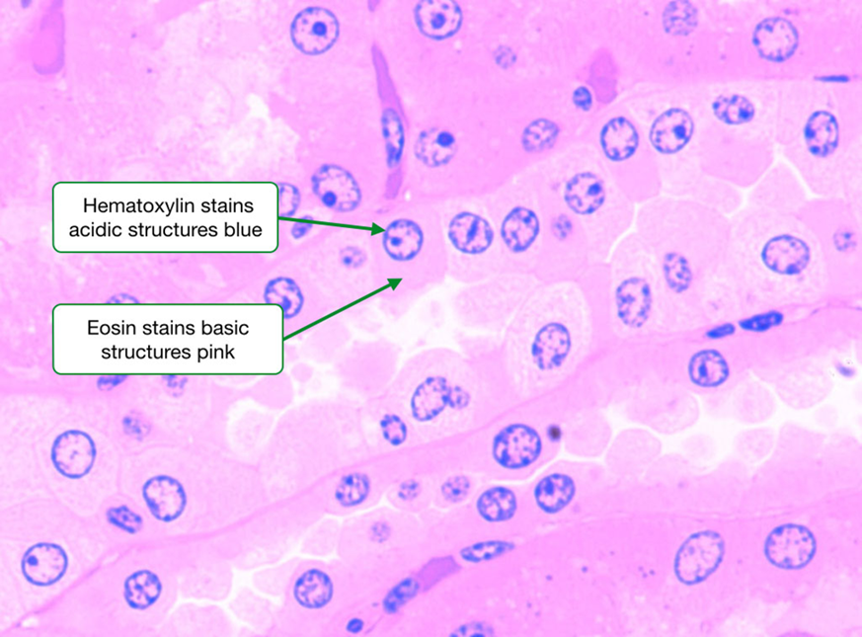
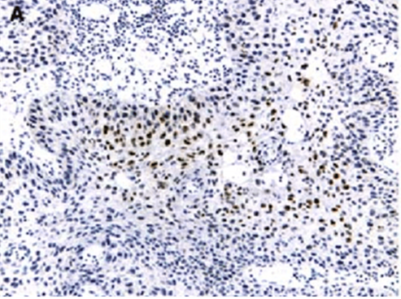
Staining Techniques
The main staining technique used is the Haematoxylin and Eosin (H&E) stain. Used in approximately 80% of cases.
Others such as Immunohistochemistry (IHC) are also used to detect specific proteins for accurate tumour classification.
In the future it may be possible to virtually create these stains using similar deep learning models without having to stain the sample itself.

Slide 17
Digital Pathology and Gastric Cancer
A 2020 study examining the diagnosis accuracy of a deep learning model using WSI in gastric cancer, showed a sensitivity at just under 100% and an average specificity of 80.6%.
Another similar study in 2019 using a re-calibrated multi-instance deep learning model showed an accuracy of 86%.
A paper published in 2021 showed predictive capability by successfully predicting the progression of a case of gastric cancer using lymph node histopathology images.

Slide 18
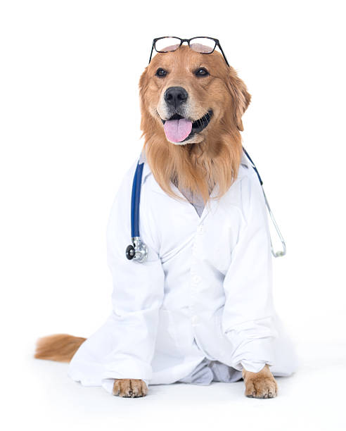
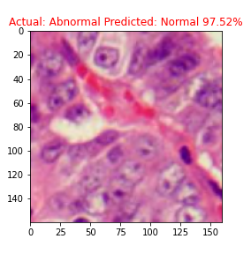
How we can use dogs to detect cancer?
Or A.I. models for Gastric Histopathology
Using real dogs is difficult
Learning what molecules dogs are detecting is also difficult
Notes:
Anecdotally cases of dogs detecting cancers in their owners (persistently pawing at skin lesions etc.)
Real dogs = very difficult (training, accuracy, administration etc)
Biomarker analysis also difficult, who wants to do that

Slide 19
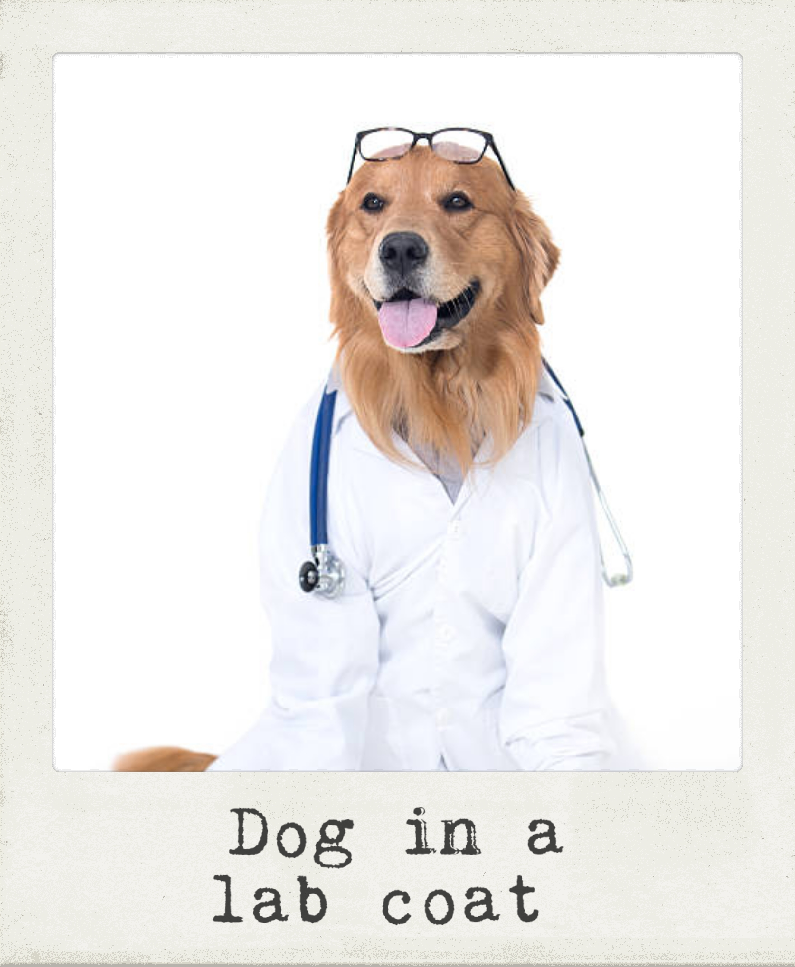
A.I models for Gastric Histopathology
A.K.A How we can use dogs to detect cancer
Using real dogs is difficult
Learning what molecules dogs are detecting is also difficult
Easier to use images of dogs to detect cancer instead!
Notes:
Instead, what we can do is, use modern computer vision techniques that identifies this picture as “dog in a lab coat” to help us identify histopathology images as malignant.

Slide 20

Computer Vision Primer – Classification +
Notes:
To give a massively brief background on what’s possible with computer vision, here are some sample things that can be done

Slide 21
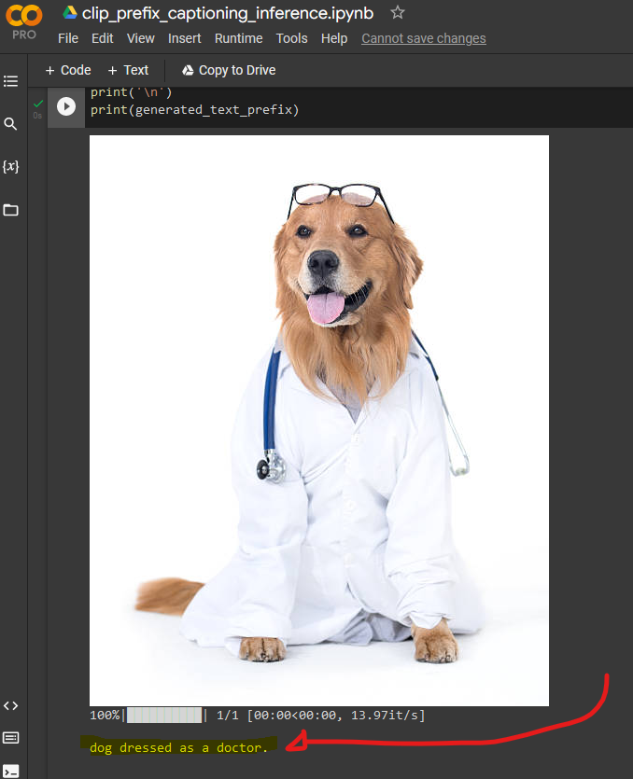
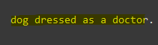
Computer Vision Primer – GPT-2 Demo
Deep Learning Models are getting progressively more sophisticated
GPT-2 was released in 2019 and is already out of date compared to current technology
Notes:
https://colab.research.google.com/drive/1tuoAC5F4sC7qid56Z0ap-stR3rwdk0ZV?usp=sharing#scrollTo=PIMiEwHI5Mx5
Computer Vision models can be combined with these large language models to be even more sophisticated in there capabilities.
To demonstrate, there is a freely available online demo that lets you generate a caption for any image.

Slide 22
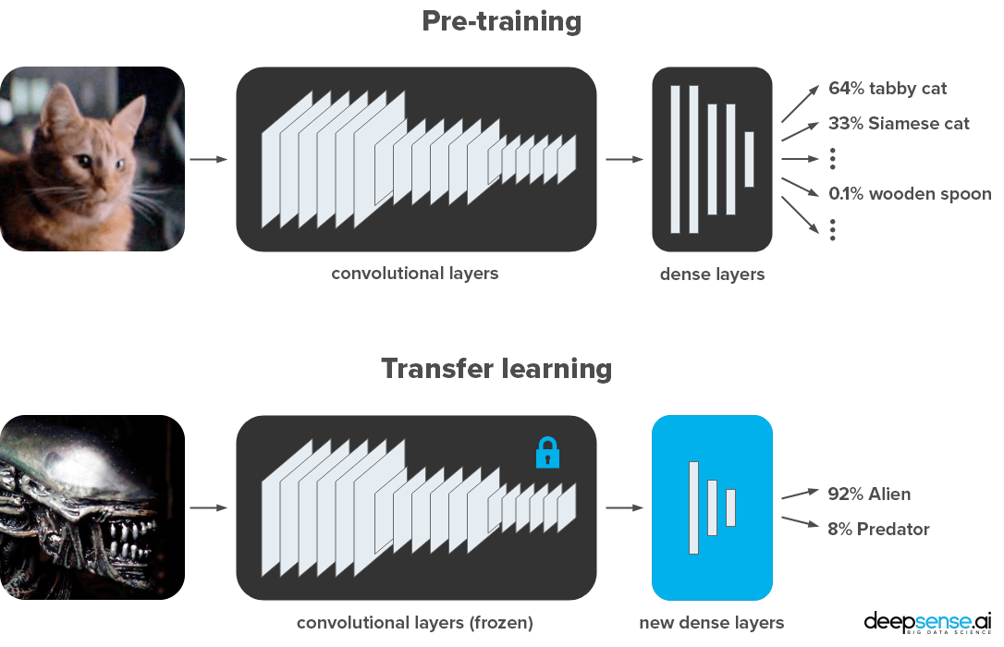
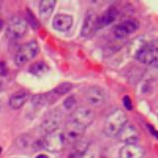
Computer Vision Primer – Transfer Learning
90% Abnormal
10% Normal
Notes:
So we’ve seen that these models can accurately identify dogs and cats, and a lots of other images. How does that help us with detecting cancers?
Well it turns out that the information these models learn in the process of identifying these everyday things can be applied to different domains.
Without going into too much detail, these computer vision models work on layers of blocks of processing and by changing just a few of the last few layers we can retarget the labels to be whatever we to identify.
So the top model was trained to identify images into 1 class out of 1000 possibilities and the modern versions of this have a top 5 accuracy of less than 3%, meaning they are better than humans. Some of these classes get quite specific (Tabby vs Siamese cats etc).
Using these already trained models then, we can freeze the processing of the initial layers and retrain just the last few to achieve our goals
Is there any questions on that before I move on?

Slide 23
Creating A.I. Models for Research
Immediate issue -> Lack of Good Data
Notes:
So that was our goal, train a deep learning model to distinguish normal histopathology images from abnormal ones.
Immediate issue was a lack of any good data. These computer vision models typically need 100,000s of images for training.
Only very recently has any datasets been available.
This paper here was actually released as a pre-print last year and that’s where I had come across it, but its not been published properly just last month.
And as we can see the authors state that this is the first publicly available gastric cancer dataset that they known of. This is technically not true, but true to a large extent as we will see later.

Slide 24
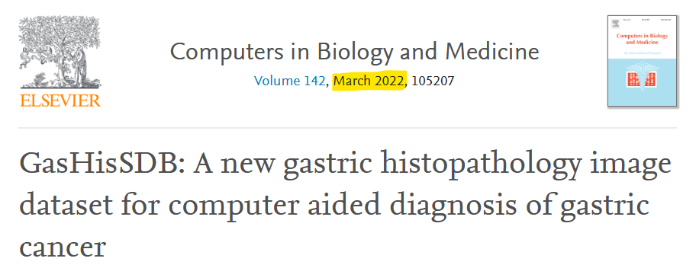
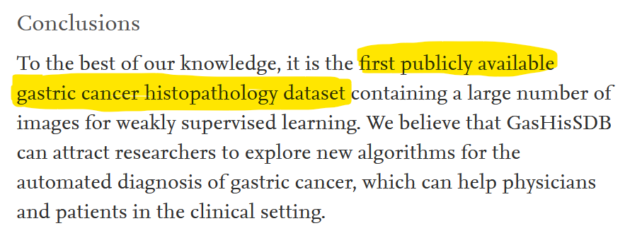
Creating A.I. Models for Research
Immediate issue -> Lack of Good Data
Hu et al. 2022
Notes:
So that was our goal, train a deep learning model to distinguish normal histopathology images from abnormal ones.
Immediate issue was a lack of any good data. These computer vision models typically need 100,000s of images for training.
Only very recently has any datasets been available.
This paper here was actually released as a pre-print last year and that’s where I had come across it, but its not been published properly just last month.
And as we can see the authors state that this is the first publicly available gastric cancer dataset that they known of. This is technically not true, but true to a large extent as we will see later.

Slide 25
Creating A.I. Models for Research
Immediate issue -> Lack of Good Data
Goal: Partially Replicate Model and Results from this paper!
Hu et al. 2022
Notes:
So seeing as this is the only (and therefore best dataset), we set out to partially replicate the results from this paper.

Slide 26
GasHisSDB Model Replication
Replication Issue -> No code supplement
A surmountable problem
DL Techniques and models used in the paper are from 2015/2016
Well supported by modern software libraries e.g. PyTorch
Replication Issue-> Hardware requirements
Training requires GPU hardware for any reasonable performance (hours instead of days of compute time)
Google Colab provides GPU usage for free
Notes:
A few more bumps in the road first however….
PyTorch -> open source software developed by FB originally

Slide 27
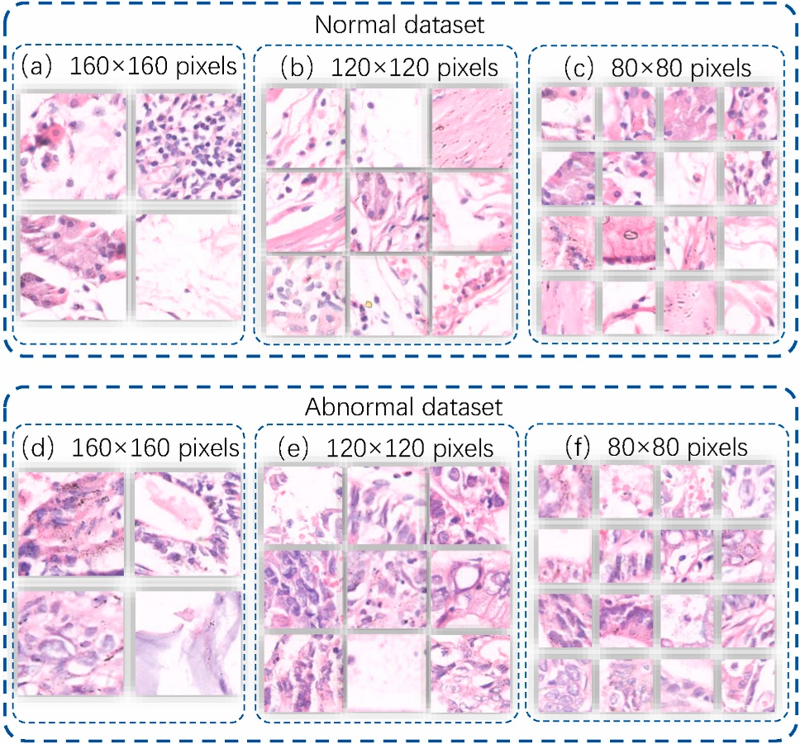
Paper Replication: Dataset
600 Whole Slide Images
2048 x 2048 pixels
Cropped into subsets depending on type denoted by pathologist team of 6
2 Classes: Abnormal & Normal
160x160 subset contains
13,124 Abnormal patches
20,160 Normal Patches
a 40/60 balance! (NB)
Notes:
Describe the process….
A 40/60 balance in dataset

Slide 28
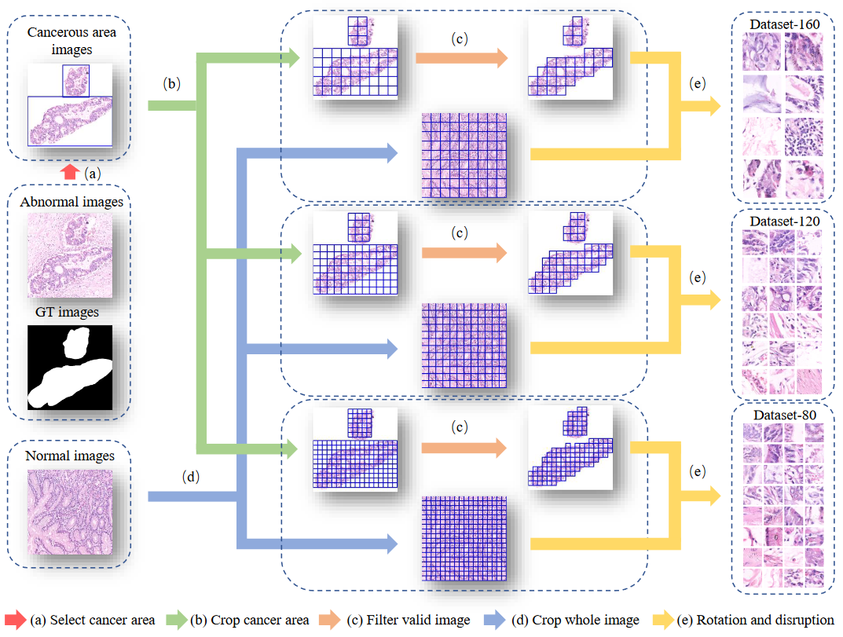
Paper Replication: Dataset
Notes:
Slightly different pipeline for abnormal vs normal images.
Key bit here is that the GT images were provided by a Histopathology review team

Slide 29
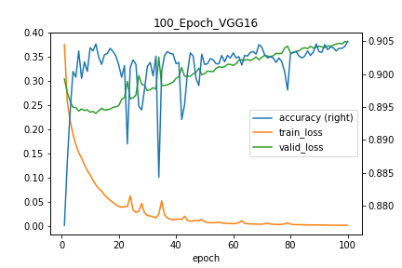
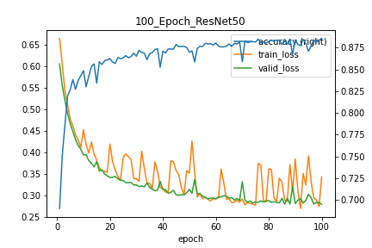
Paper Replication: Model Training
VGG16 Architecture
Better Performance
Drastic Overfitting
ResNet50 Architecture
Slightly worse performance
Theoretical Better Architecture
Notes:
So coding up the models in python (using Google Colab), we get these results.
The orange and green lines show training and validation loss.
Training loss essentially is a measure of how well the model is performing during its training phase.
Validation loss is how well the model performs on a set of data it hasn’t trained on yet, and indicates how well it might due on a brand new dataset of images.
Blue is accuracy and uses the right axis, and as we can see the models get around 85%-90% accuracy.
I trained 2 models, VGG16 and ResNet50, both of which are from around 2015/2016, which is quite dated in deep learning to be honest.

Slide 30
Paper Replication: Test Results
Original Paper |  |  |  |  |  | Replication
Model | Total Epoch | Model size | best eopch | training time | Accuracy | Accuracy
VGG16 | 100.00 | 268.16 | 100.00 | 13 873 | 95.90% | 94.12%
ResNet50 | 100.00 | 83.12 | 84.00 | 10 023 | 96.09% | 88.54%
Notes:
So the results under the blue heading are the original ones from the paper, and the ones at the end are the results from the 2 models I coded and trained.
As we can see the performance is broadly in line with what they achieved and is quite high in general.
A histo-pathogist might have a 98% accuracy rate
So brilliant open and shut case, these models work, thanks for the being here etc….

Slide 31
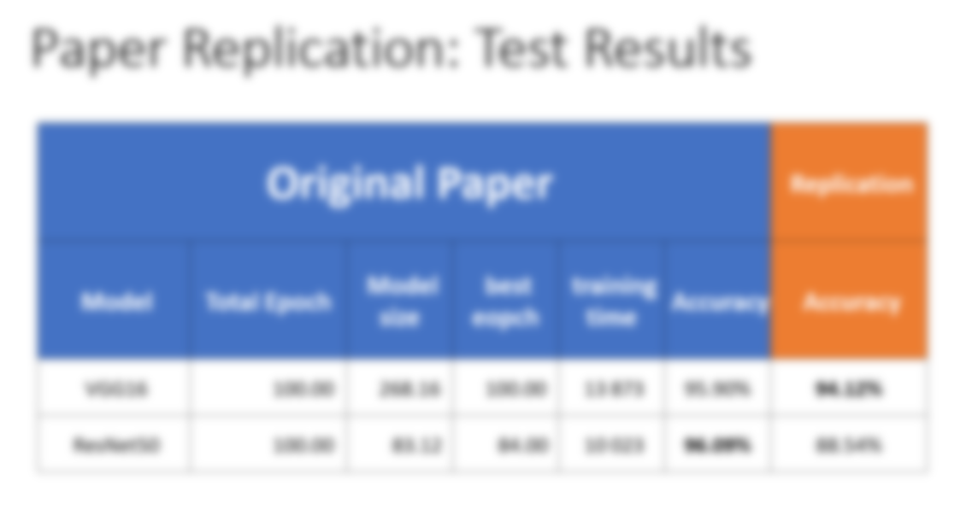
-DONE-
Notes:
So the results under the blue heading are the original ones from the paper, and the ones at the end are the results from the 2 models I coded and trained.
As we can see the performance is broadly in line with what they achieved and is quite high in general.
A histo-pathogist might have a 98% accuracy rate
So brilliant open and shut case, these models work, thanks for the being here etc….

Slide 32
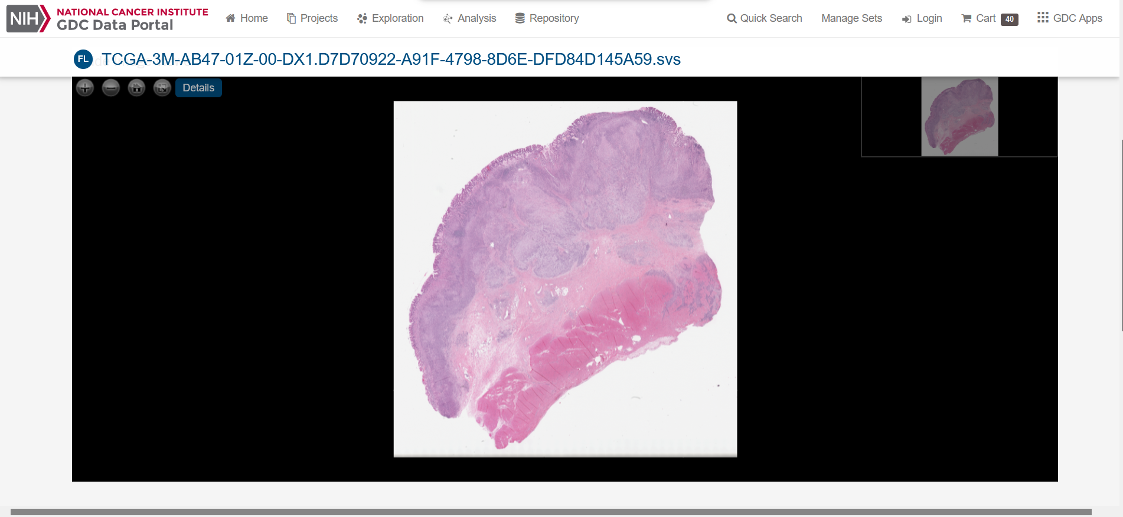
Testing in the “Real World”-TCGA Dataset
Notes:
So while the GasHisSDB might be the 1st publicly available dataset that has been curated for a deep learning classifier explicitly, its not the only dataset our there that’s publicly available.

Slide 33
Testing in the “Real World”-TCGA Dataset
DEMO

Slide 34
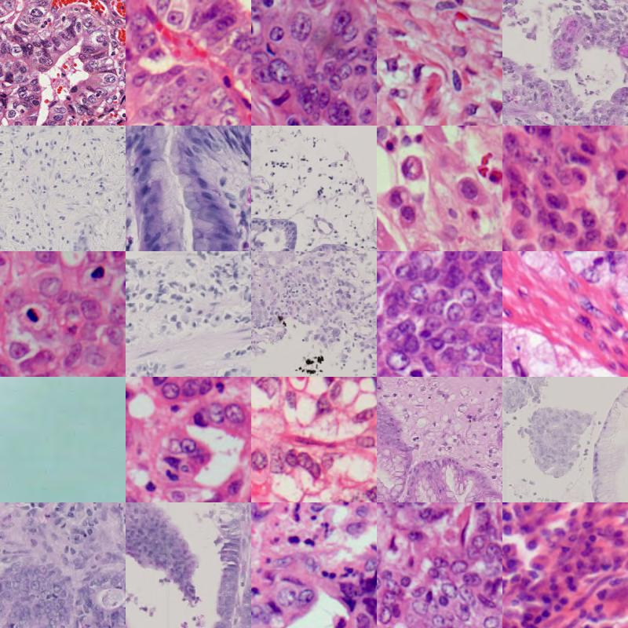
TCGA Dataset - Patch Creation
Another set of software needed to create
Assumptions Req’d
Diagnostic Images Only
Large variation
Not original intention
40 WSI downloaded
35 patches tested
Notes:
So to even use these images, we have to follow some of the pre-processing steps that the GasHisSDB paper employed.
Only abnormal images
No GT or pathologist handy.
Need to detect tissue somehow (a lot of white space).

Slide 35

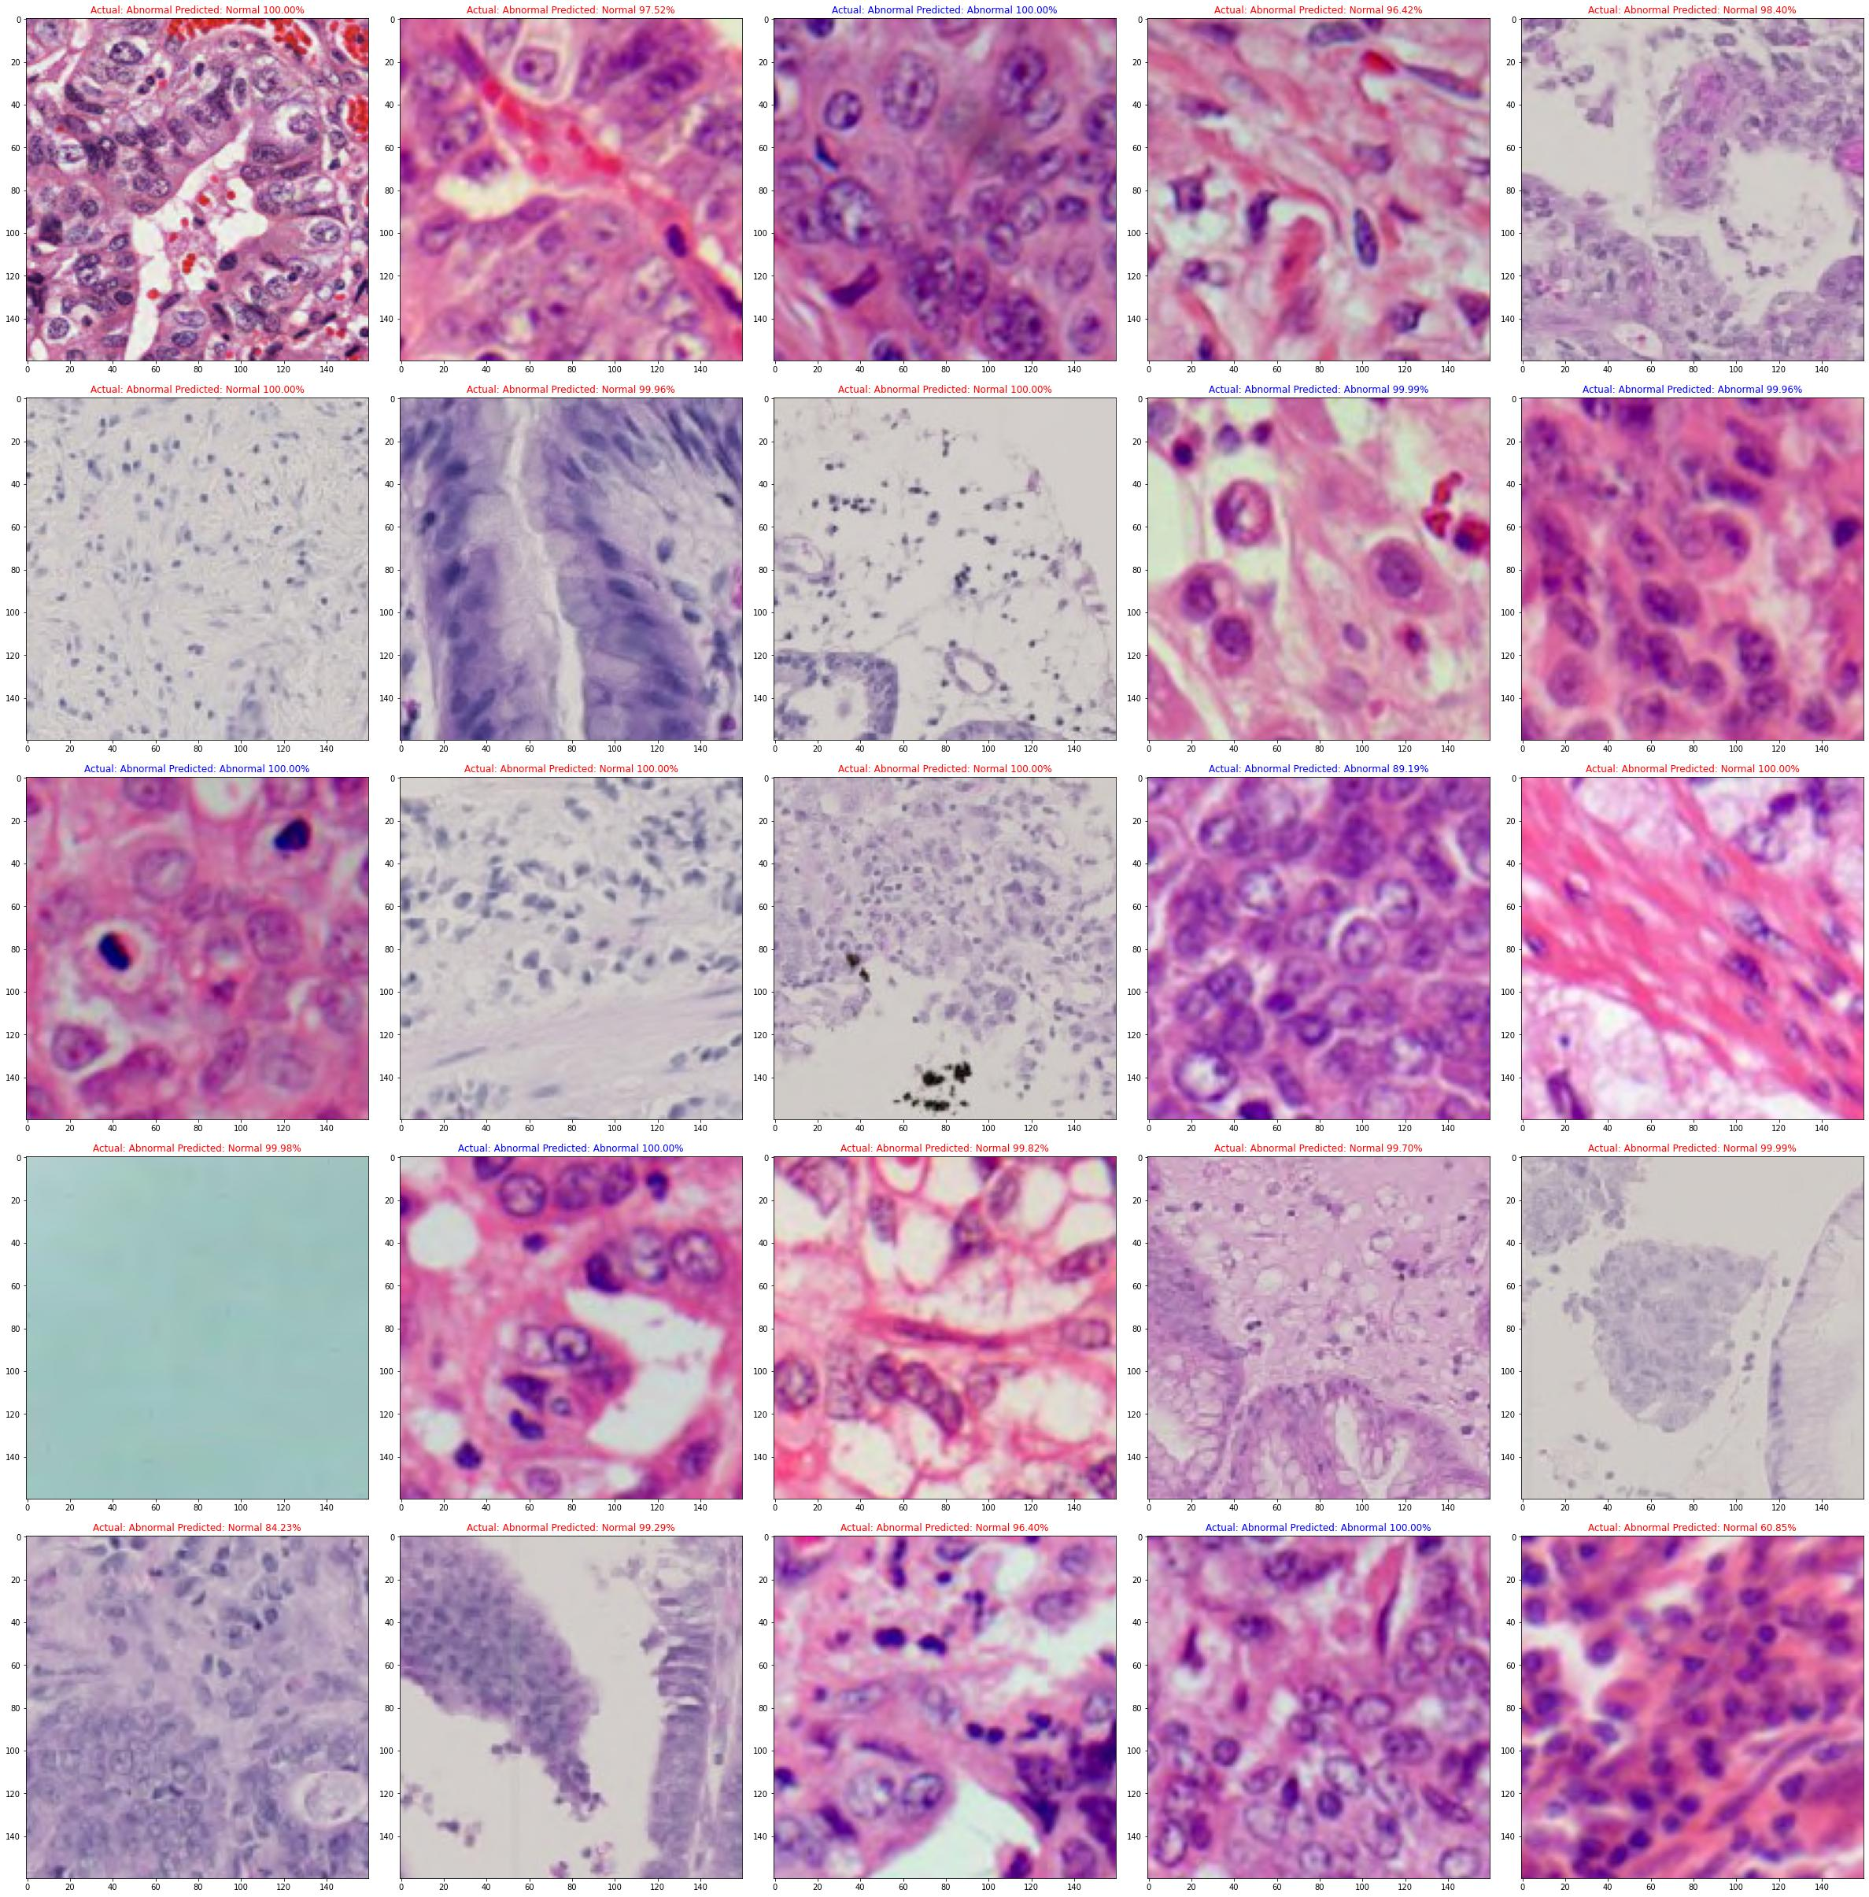
TCGA Dataset - Testing
15/35 Correct or 42.86%
Worse than random!
Notes:
So how did we do? Terribly, in fact worse than if we flipped a coin bad.
That actually means that if we took the results our model gave us and actually said the exact opposite, we would have 58% accuracy

Slide 36
TCGA Dataset - Results Interpretation
Poor Generalization – Not enough data
WSI Image Size (100,000 x 100,000)
Annotation Quality
Black-box Model
Notes:
So what happened that our model was so good in 1 situation but so bad in another?
Just to note, the originally paper makes no claims that the models they trained would generalize. The main outcome of the paper was the creation of the dataset itself. I don’t want to imply that the paper is poor, just to highlight the well known pitfalls that deep learning models have when they are not utilized correctly.

Slide 37
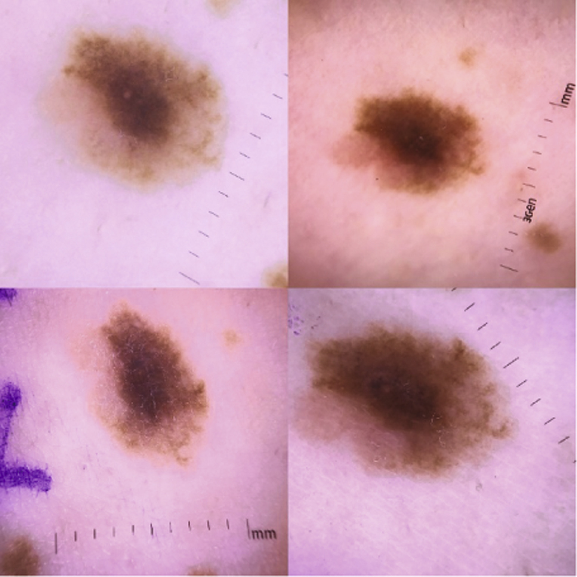
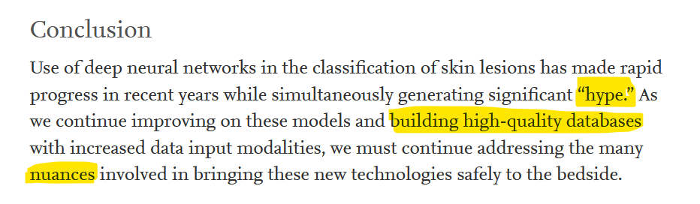
Black-box Model - Pitfalls
Skin Cancer Detection Model
Black-box = Just outcome, no explanation
Explainable A.I. ->
“Presence of Ruler = likely Cancer”
Narla et al. (2018) Automated classification of skin lesions: from pixels to practice
Notes:
Just to highlight how bad these black-box models can be, here is a some what famous example in the field.
Some trained systems that were trained to detected cancer from skin lesions, one they were analysed with a different A.I. technique revealed that they were using the presence of a ruler to help infer the likelihood of cancer.

Slide 38
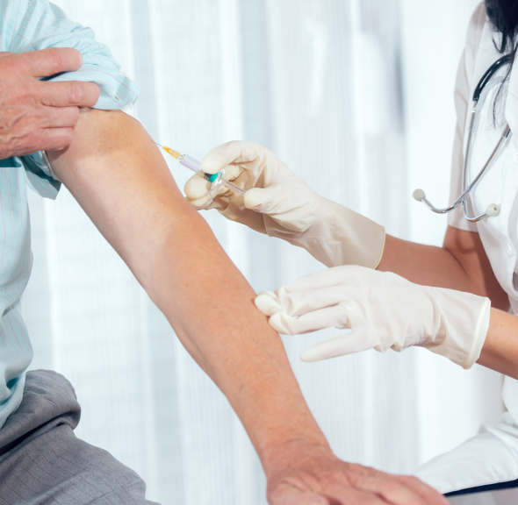
Additional options: clinical trials and personalized treatments

Slide 39
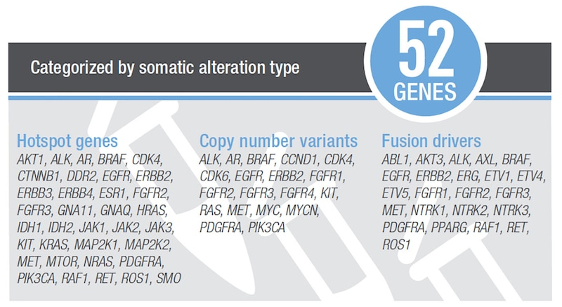
Genetic profiling of somatic alterations with NGS and OFA – 2020 study
Oncomine Focus Assay: a multi-biomarker assay that can detect variants across 52 cancer-associated genes from DNA and RNA in one single workflow
Notes:
As previously stated, analysis of gastric cancer is complicated due to both its etiological and histological heterogeneity. A 2020 study out of South Korea set out to rectify this by determining a method of genetic profiling of somatic alterations in gastric cancer. The study utilized NGS with the OFA (Oncomine Focus Assay), a “multi-biomarker assay that enables the detection of variants across 52 cancer-relevant genes from DNA and RNA in a single workflow” [5] and they used it to compare pathological characteristics with the mutation profiles of 50 patients with stomach cancer.

Slide 40
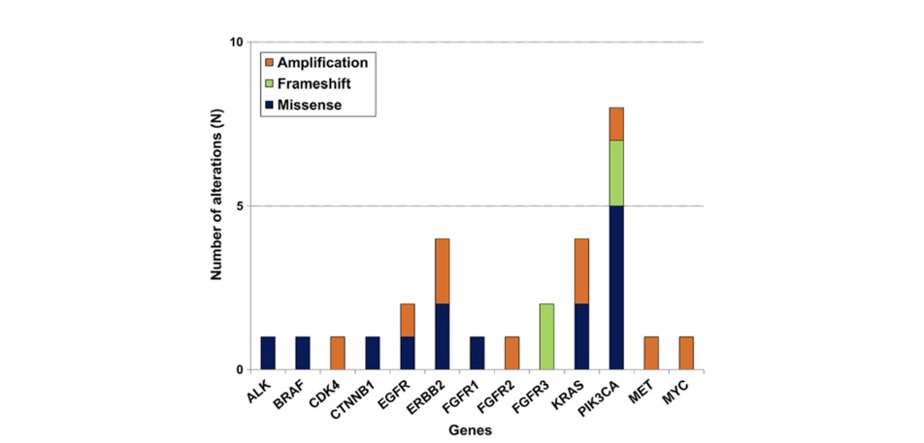
Somatic alterations identified
50 patients
22 with somatic alterations
8 with PIK3CA alteration
Notes:
Out of the 50 pts, at least one somatic alteration was detected in 22 of them, including single nucleotide variants, insertions, deletions, and amplifications. Out of the 22, alterations in the PIK3CA were the most common, found in 8 of the 22 variants. Additionally, alterations in ERBB2, KRAS, EGFR, and FGFR3 were found in multiple quantities.

Slide 41
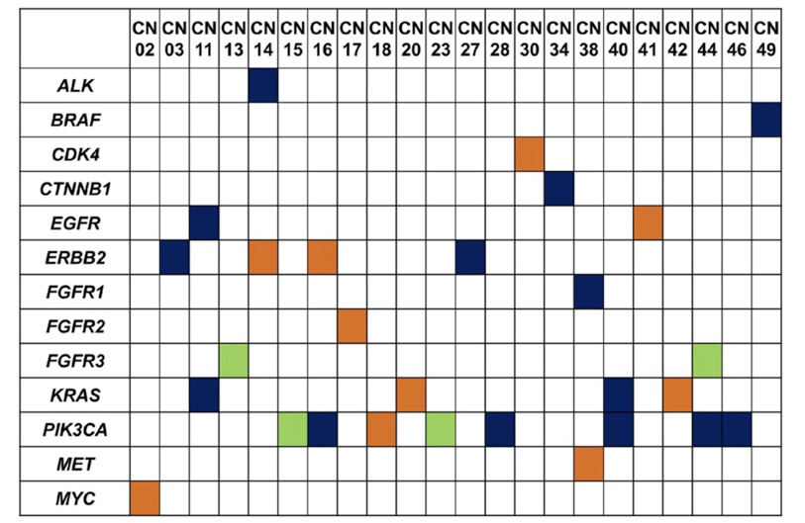
Implications
Notes:
This study was a novel approach to stomach cancer research that used the new OFA technology to create a profile of molecular classifications that could be used as a precision medicine tool. It is an avenue that shows promise for future research, and we would recommend a patient with gastric cancer enroll in a similar study. Ultimately, the discovery and classification of the types of mutations that cause stomach cancer can help aid future diagnosis and improve clinical outcome for future patients.

Slide 42
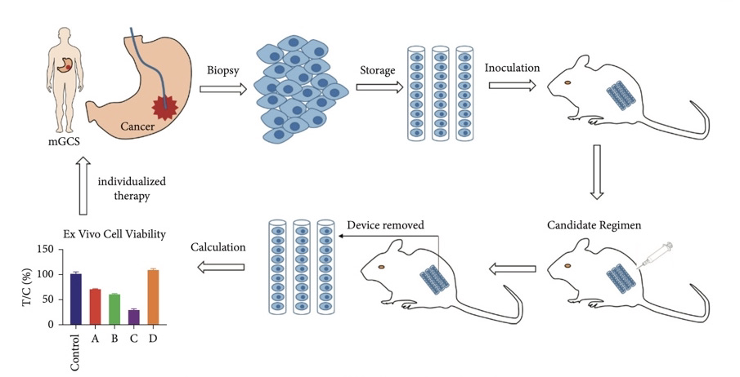
Personalized treatment of stomach cancer using the MiniPDX model – 2022 study
Notes:
This was a 2022 research study out of China: used the OncoVee MiniPDX (patient-derived xenograft) model to predict the sensitivity of cancer drugs, with the goal of pre-determining efficacy and potential side effects of cancer drugs before they are administered to patients.
In the MiniPDX research model, cancer tissue is biopsied under endoscopy and the tumor cells are implanted into mice. The assay produced from the candidate regimen can then be used to devise treatments for the patients.

Slide 43
Advanced stomach cancer: additional complications
Malnutrition and general poor physical health in gastric cancer patients
Rapid progression of gastric cancer and short survival period
Need for quick diagnosis and treatment that is effective while minimizing adverse reactions and toxicity

Slide 44
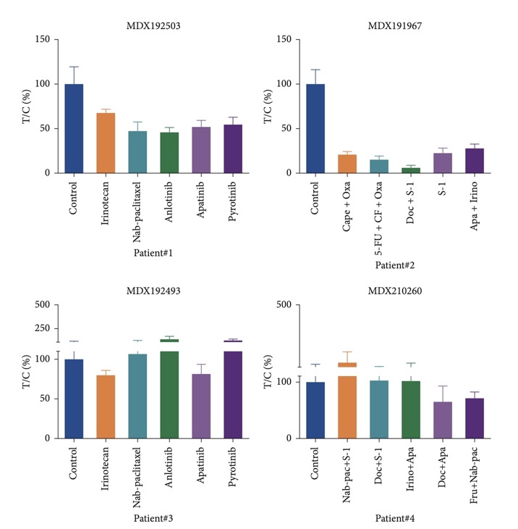
Using the MiniPDX - results
Notes:
The MiniPDX models used in this study identified personalized drug treatments that resulted in partial remission for 2 out of the 4 patients and no negative side effects in any of the 4 patients.
The MiniPDX model can generate drug sensitivity results in 7 to 10 days, allowing quick and continual adjustment to new methods of treatment for the patients based on the results of the PDX.

Slide 45
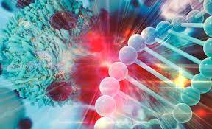
Future Potential
Notes:
The MiniPDX has also been successfully used in other cancer studies: in an RCT on gallbladder cancer, patients in the PDX group had both longer overall survival and longer disease-free survival.
Based on the recent study on gastric cancer as well as the studies on other cancers, utilization of a MiniPDX model would be a strong recommendation for treatment of a gastric cancer patient.

Slide 46

Any questions?

Slide 47
References

